Slide 1
Project Plan and information plan website
Title website :
Guide to have a good start in Minecraft

Slide 2
Purpose of the website
The purpose of this website is to help people who want to play Minecraft.
This guide will show everything from where it can be buy to the end of the game.
I expect people following the instructions on the website. People can do exactly the same thing as written on the website or they can just have a look about the way the website explain on a topic.

Slide 3
Unique selling proposition
The website will be THE reference for the game. Every players will know about it so if someone want to play, players just have redirect to the guide.
The website will be divided in different sections so it will be easier to navigate between the pages.
Each part of the guide will be well detailed so beginners will understand easily the guide.

Slide 4
Description of the target group
Beginners from all ages are targeted.
In fact, young people will create the majority because they play more videos games than adults.
Because it will be THE reference, each players will now about it.
For instance, there are 4 possible players who could follow or read the guide.

Slide 5
Name: Roberto Sex: Male Age: 16 years old Status: Single Location: USA | Goals in context Roberto likes to play videos games with his friends after class. Everyday, he tries to become a better player. | Bio Roberto is a student in high school. With his friends, they play to Minecraft after class.
 |  | Interests Roberto wants to join a team of e-sports players in Minecraft.
 | Frustrations in context Roberto wants to be the best player around his friends.
 |  | Preferred habits Roberto doesn’t like to watch a video to understand something, he prefers reading books and articles.

Slide 6
Name: Anke Sex: Female Age: 12 years old Status: Single Location: Germany | Goals in context Anke has received her first computer for her birthday. She wants to play Minecraft because of her interests. | Bio Anke is in middle school. She likes relaxing by playing video games during the holidays.
 |  | Interests Anke is passionate by arts and architecture.
 | Frustrations in context Anke doesn’t know how to play Minecraft, she is looking for a website who explained how to do it.
 |  | Preferred habits Anke prefers websites with good explanations for a better comprehension.

Slide 7
Name: Frank Sex: Male Age: 45 years old Status: Married Profession: Dentist Location: United Kingdom | Goals in context Frank has bought recently Minecraft for his sons for the holidays. Frank wants to play with them. | Bio Frank is a father of 2 twins. They are 14 years old.
 |  | Interests Frank likes videos games and tries to play to the same games as his sons.
 | Frustrations in context Every time Frank wants to play to a new game, he is stucked by his age and he had never succussed to find a website how explain well the game.
 |  | Preferred habits Frank likes website well explained on Internet.

Slide 8
Name: Maria Sex: Female Age: 25 years old Status: Single Profession: Youtuber Location: Australia | Goals in context Maria started YouTube since 1 year. Lot of people follow her activities and recently, she started to play video games. | Bio Maria lives in her apartment. She has finished her studies and she works as a youtuber.
 |  | Interests By playing a famous game, she can have more viewers. Also, she likes the concept of the game.
 | Frustrations in context She has never played Minecraft. She wants to do her best by finding some information to how to started.
 |  | Preferred habits Maria prefers reading than watching a video.

Slide 9
Landing page
NavBar
Title + links to others pages
Minecraft in few words
Body of the page
Big summary of the website with little explaination of each part + link to each page
There are not every parts of the summary on this sketch.
Summary
How to Install
Home Menu
Contact Page
Footer
Name of the author + social medias

Slide 10
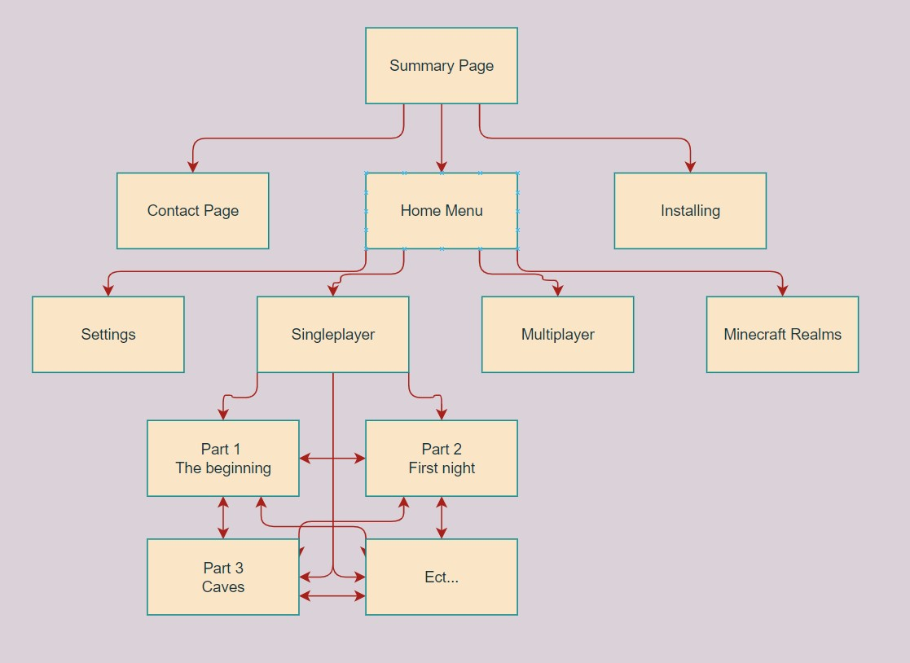
Project Plan Information Architecture

